Slide 1
Leroy Merlin
TV App Agency

Slide 2
Revision History
Version | Date | Description | Author
1.0 | 2013.03.12 | Document created | Wasim Ahmed

Slide 3
Contents
Description of App
UI Structure
Detailed Functions Description
Key policy
Usage Scenario
Notes for testers(optional)

Slide 4
Description of App
Items | Contents
Purpose of App | View videos for Leroy merlin
Category | Lifestyle
Functions | Watch DIY videos from Leroy Merlin
Multi languages(required) | Check whether multi languages are supported or not. □ Yes □ No✓
Supported Languages | Spanish
How to change languages | N/A

Slide 5
Description of App
Items | Contents
Sound(required) | Check whether Sound system is supported or not. □ Yes✓ □ No
3D contents(required) | Check whether 3D contents and functions are supported or not. □ Yes □ No✓
DRM | N/A
Programming Lanuage | Javascript
External Devices | (e.g., USB, Mobile Devices, Mouse, Keyboards…)
Single Sign-On(SSO) | □ Yes □ No✓
GeoFiltering | N/A
Other Features/ Information for testing

Slide 6
Description of App
Items | Contents
Keyboard(required) | Check whether Keyboard system is supported or not. □ Yes □ No✓
Mouse(required) | Check whether Mouse system is supported or not. □ Yes □ No✓
Gesture(required) | Check whether Gesture Function is supported or not. □ Yes □ No✓
voice Recognition(required) | Check whether voice Recognition Function is supported or not. □ Yes □ No✓
Interworking with Kids(required) | Check whether your app is interworking with Kids App or not. □ Yes □ No✓
Interworking with Fitness(required) | Check whether your app is interworking with Fitness App or not. □ Yes □ No✓
Interworking with YourVideo(required) | Check whether your app is interworking with YourVideo App or not. □ Yes □ No✓
Ticker(required) | Check whether your app Ticker App or not. □ Yes □ No✓

Slide 7
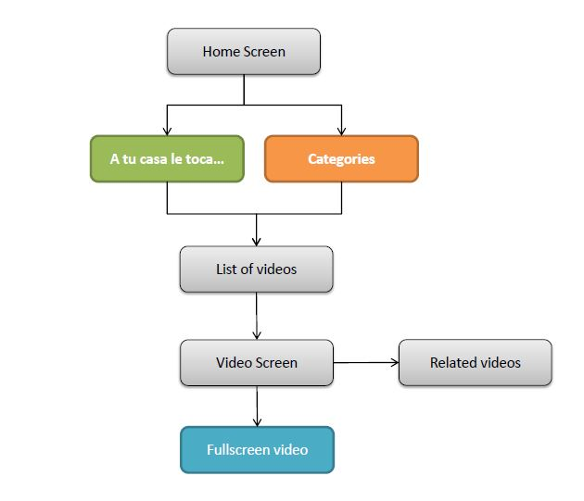
UI Structure - Sitemap

Slide 8
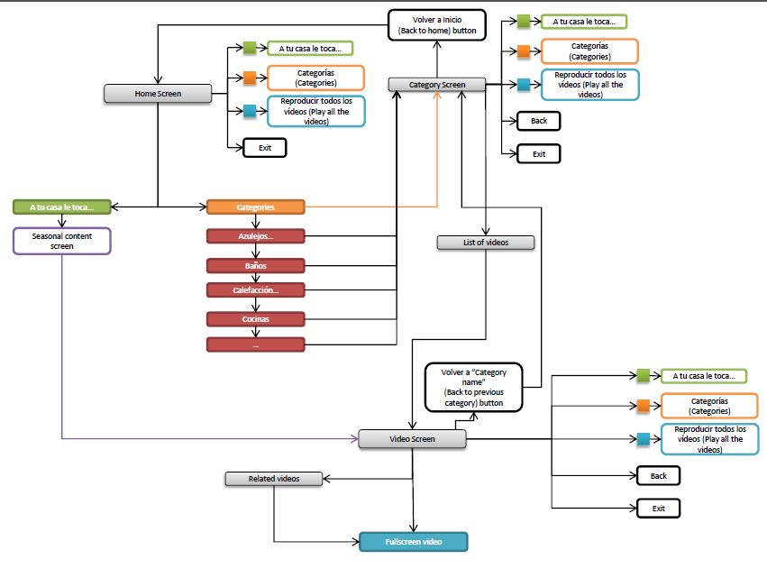
UI Structure - Workflow

Slide 9
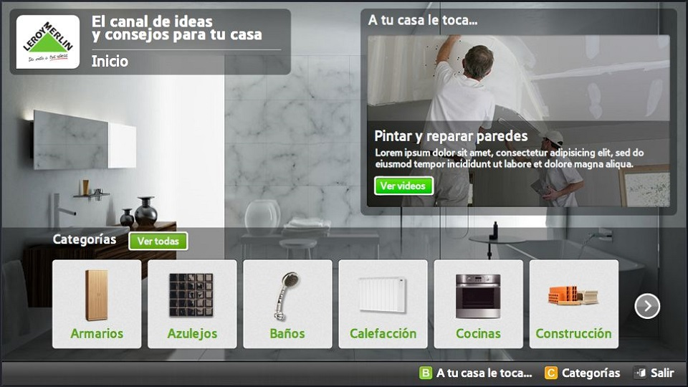
Home Page

Slide 10
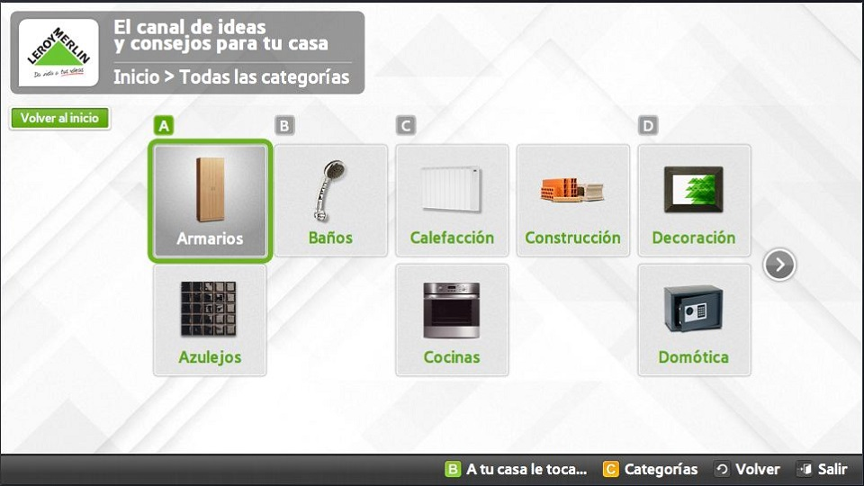
Categories Page

Slide 11
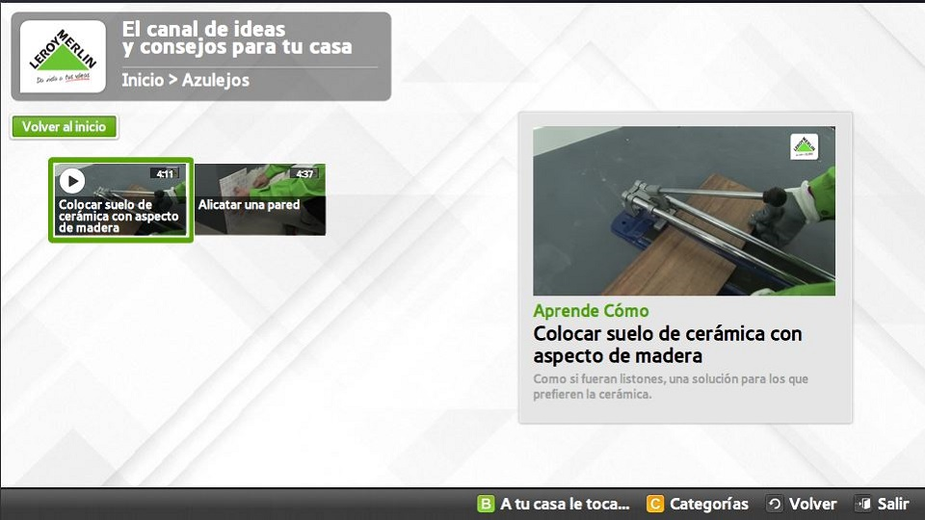
Ver Video

Slide 12
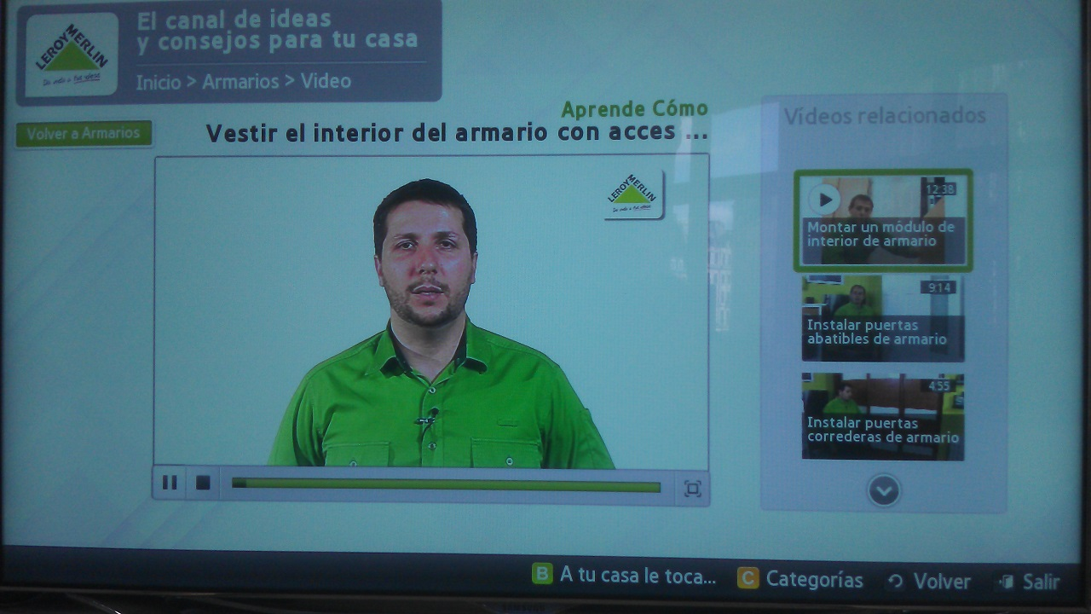
Video

Slide 13
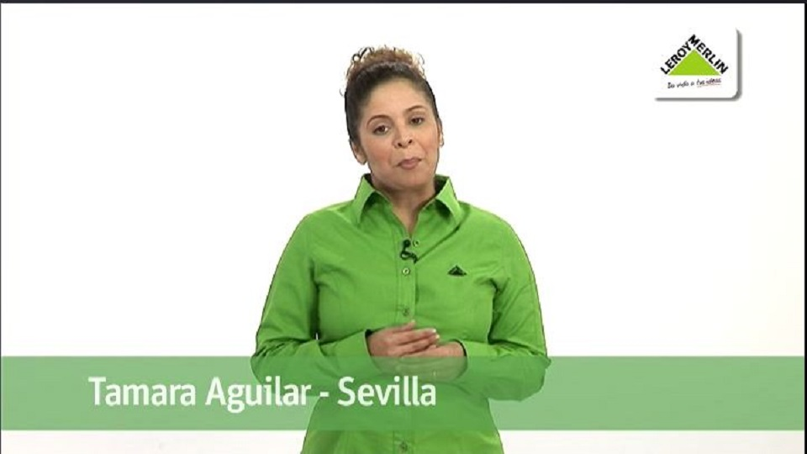
Full Screen Video

Slide 14
Key Policy
Button | Action | Remarks
ENTER | Make selection
UP/DOWN | Move highlight up or down
LEFT/RIGHT | Move highlight to left or right
YELLOW | Categorias (Categories)
GREEN | A tu casa le toca (Seasonal Content)
RETURN | Move to previous page | Samsung Mandatory
EXIT | Close the app and show broadcasting channel | Samsung Mandatory

Slide 15
Usage Scenario
1.Home
Focus in the seasonal videos category, right part of the screen. The video shown can change monthly. Categories are shown below, in alphabetical order
2. Category screen
Focus on the selected video.
If the user hasn’t selected a video, the first one has to appear selected.
The big image shown in the right of the screen is a static preview of the video. If the user wants to view a video, he has to select it and it leads to section 3.
3.Video screen
Video selected appears in the left of the screen. A list of the related videos appears in the right part of the screen.

Slide 16
Usage Scenario
4. Fullscreen videos
Video controls of the remote rule this mode. “Back” button to close the full screen video and go one step back.
The "Ver todos los videos" (Play all the videos) option allows the user to watch all the videos of the platform. The user can jump from one video to the next.
Please notice that no video controls will appear in full screen mode.
5.Categories overview
List of the categories in alphabetical order. Each category leads the user to section 2.

Slide 17
Notes for testers (optional)
If you need to notify some information to testers, please write here.
All information for testing will be helpful.

